Slide 1
Project Architecture
Using Go language

Slide 2
Domain Driven Development(DDD)
software development approach
What is the Domain?
  Business logic
What is Domain-Driven Design?
  Tackling Complexity in the Heart of Software
  is the expansion upon and application of the domain concept, as it applies to the development of software
  It aims to ease the creation of complex applications by connecting the related pieces of the software into an ever-evolving model
  DDD terms :
    (Context,Model,Language,Bounded Context)
Building Blocks
  Entity,Value Object,Domain Event,Aggregate,Service,Repositories,Factories

Slide 3
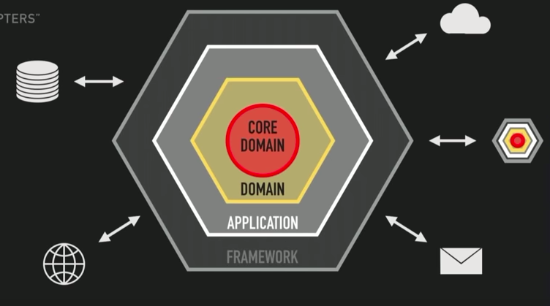
Hexagonal
The goal of hexagonal
are the layers is like MVC layers ??

Slide 4
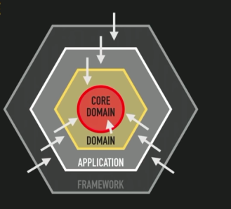
Hexagonal
how to achieve hexagonal goals
  core domain -- what is it ??
  the rest of the application will implement those interfaces to satisfy the domain’s need

Slide 5
hexagonal
3 principles of hexagonal architecture
  separate Application to layers
  Dependencies are going from outer layers to the center
  isolate the boundaries by using Ports and Adapters
    ports are defined by the business code (inside)
    Adapters represent the external code (out side) make the glue between the port and the rest of the application code or infrastructure

